Slide 1
Multi-tenancy vs White-labelling - Concepts
Multi-tenancy
White-labelling
Security & data boundary
Run many businesses on one platform
Ensures isolation of platform customers
Shared infrastructure + scalability
Who is allowed to see/do what?
Tenant aware services
Operational separation
Brand and experience boundary
Businesses present the platform as their own
Ensures isolation of brands at runtime
Capabilities presented differently
Configurable product look & feel
Brand identity

Slide 2
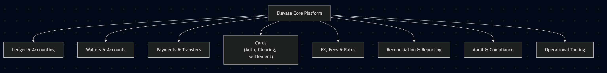
Elevate core capabilities
Wallets & Accounts
Double-entry accounting
Payments and transfers
FX & fees
Reconciliation & reporting
Operational portal
Compliance & audit
Card authorisation & settlement
Elevate is single-tenant
One logical customer base
One general ledger
One operational boundary
One brand
Implicit EMI (Frontier Pay)

Slide 3
Multi-tenancy = Single-tenancy +
Explicit tenant identity
Tenant aware authorisation
Hard isolation
Per tenant reporting
Auditable separation of customer data

Slide 4
White-Labelling = Multi-Tenancy +
Brand identity
Domain & routing
Brand specific communication
Brand specific product packaging

Slide 5
Migration roadmap

Slide 6
Detailed milestone breakdown
Task | Effort (person –days)
Discovery & design | 5-7
Tenant Identity Model | 3-5
Tenant-aware authorisation | 5-7
Tenant-partitioned schema & migrations | 15-20
Enforced isolation (GraphQL + services) | 10-14
Multi-tenant readiness testing | 5-7
Brand layer (domain->brand->tenant) | 5-7
White-labelling (UI, comms, packaging) | 8-12
Total | 56-79

Slide 7
Multi-tenancy vs White-labelling - Dimensions
Dimension | MT | WL
Core platform | Shared | Shared
Data isolation | Mandatory | Mandatory
Branding | Same | Custom
UX | Same | Custom
Business rules | Same | Custom
Pricing / Fees | Same | Custom
Regulatory | Uniform | Uniform
Operations | Single Ops view | Brand specific Ops view
Development effort | Backend heavy | Config heavy

Slide 8
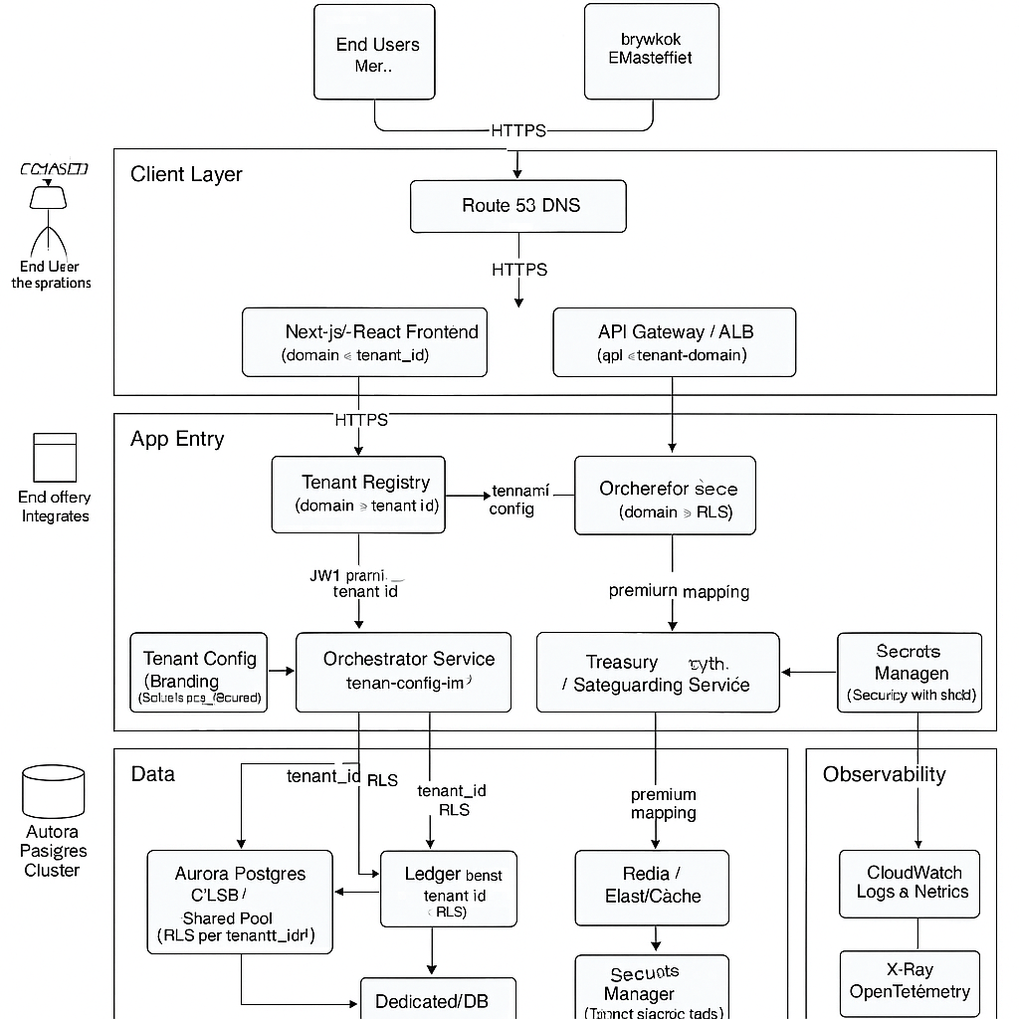

Slide 9
Payment Capabilities
Elevate Core Banking
Web Portal
BI/Analytics
Virtual IBANs
Banking Circle
Card Processing
KYC
Onboarding
TX Monitoring
Audit/SAR
Wire Wand
FX Services
Bank of London
Reporting
Settlement
Reconciliation
Integration
Company’s House
Domestic Payments
Equals Money
Payment Services Connectors
Credit Safe
Orchestration
Account Management
Multi-currency Wallet
General Ledger
Cross-border Payments
Convera
NCA
Settlement
Payments
Debit Cards
Foreign Exchange
Crypto
Clowd9
BACS, CHAPS, FPS
Orchestration Rules
Ledger DB
Operational Datastore (ODS)
Accounts
SEPA

Slide 10
Payment Event Processing
Front-end
Service Provider
Virtual IBANs
API Gateway
Banking Circle
FX Services
GraphQL
REST
Account Management Service
User Service
Domestic Payments
Transaction Processing Service
Equals Money
User created
Transaction event
Notification Service
Middle Tier
Front End Services
Orchestrator
Card Service
Cross-border Payments
Funding events
Convera
Events
Integration Layer
Connectors
FX Service
Settlement
DB Events
Authorisation events
Events
Payment Database
Bank of London
BACS, CHAPS, FPS
Ledger Service
Verify Identity
SEPA
Authentication Service
Card Processor
Cards Network
Supporting Layer
KYC Service
Fraud Detection Service
Analytics Service
Logging & Monitoring Service
Events
User Portal
Analytics Portal
Operation Portal

Slide 11
Core processing – Data flows
Card Processor
Web App
Mobile App
FPMS
Card Processor
Banking Partner
FX provider
Requests
Notifications
Events
GraphQL
REST (webhook)
ODS
Ledger
Data API
Journal data
Reconciliation
Action
Orchestrator
Orchestrator
Transactions
Risk Assessment
Payment Service
FX Service
Card Service
REST
Payment Monitoring
Payment Connector
FX provider Connector
Card Connector
Payment Event Processor
FX Event Processor
Card Event Processor
Event
BI/Analytics
Banking Partner
FX Provider
Card Processor
Event Channel

Slide 12
Hasura event trigger processing
Operational Datastore
GraphQL mutations
Hasura events
Serverless functions

Slide 13












GraphQL engine infrastructure design
Hasura docker image
VPC
Mobile client
Web Client
Load Balancer
Amazon RDS
ECS
Microservices
Amazon ECR
IAM
CloudWatch

Slide 14
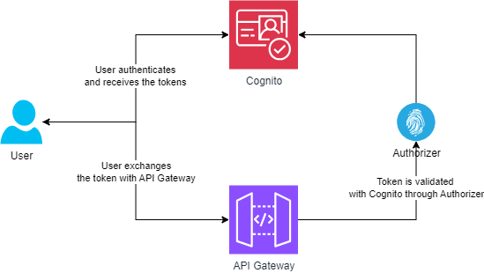
Cognito as Authoriser – High level Architecture

Slide 15
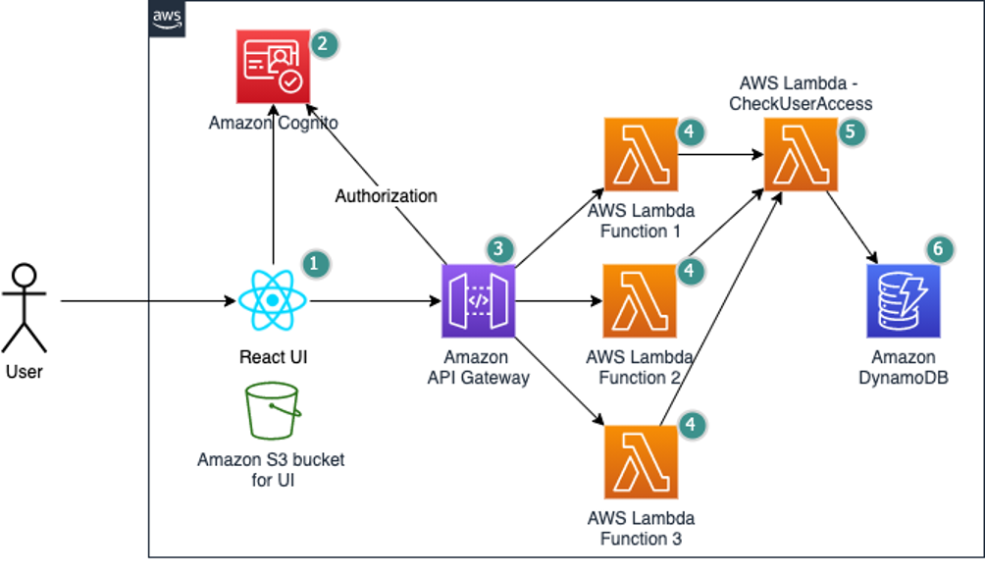
Fine grained authorization – High level Architecture

Slide 16
WebApp architecture options
Amplify + AppSync + Dynamo DB
Amplify + AppSync Introspection + Aurora cluster
Amplify Data ... (Powered by AppSync + Dynamo DB)
Amplify + Apollo + AppSync + Aurora cluster

Slide 17
React App
API Gateway
Serverless Lambda
Message Queue
Database
Accounting
Fraud Detection

Slide 18
AWS Environment
API Gateway
Code Build EC2
Serverless
Ledger Service ECS
Postgres

Slide 19
Banking Circle Account creation scenarios
Create a GBP account – A new VIBAN is created and linked to GBP master account
Create a currency account – A new VIBAN is created. Supported local IBANs are also provided
Create a multi-currency account – A new IBAN created and associated with multiple master accounts each in its own different currency

Slide 20
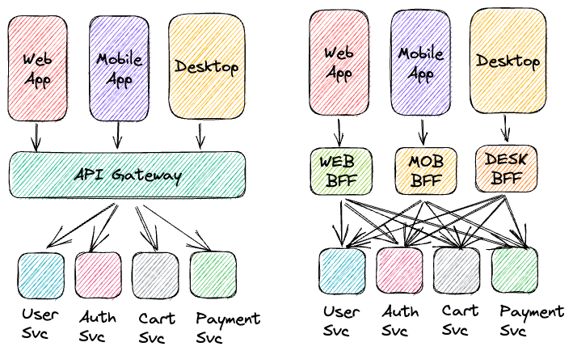
Backend for frontend (BFF)

Slide 21
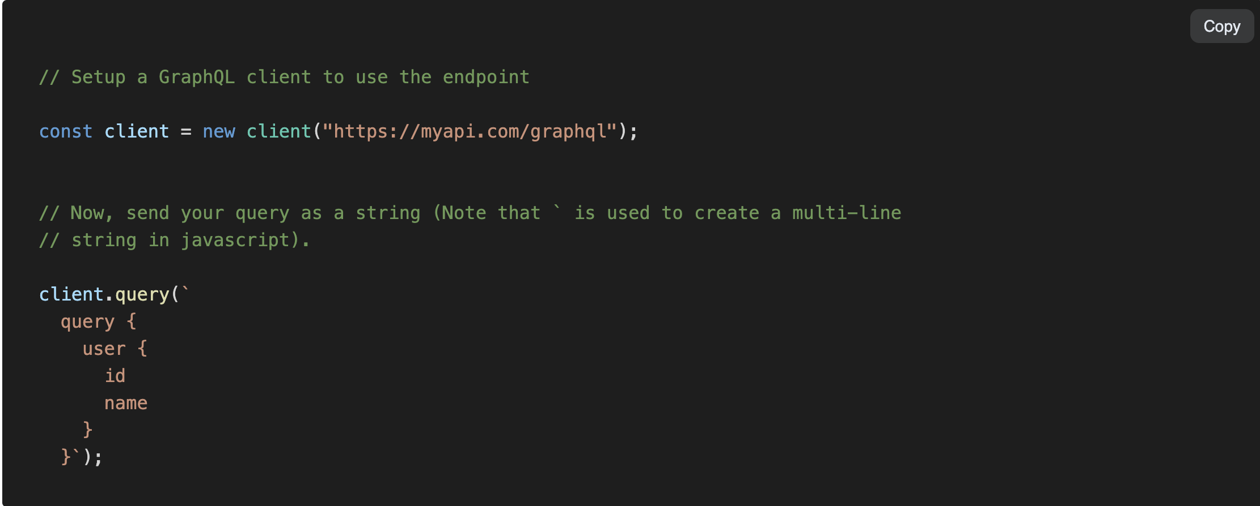
Hasura authentication

